Slide 1
From the sky the highway’s straight as it could be
John B. Cole
URUS Group LP

Slide 2
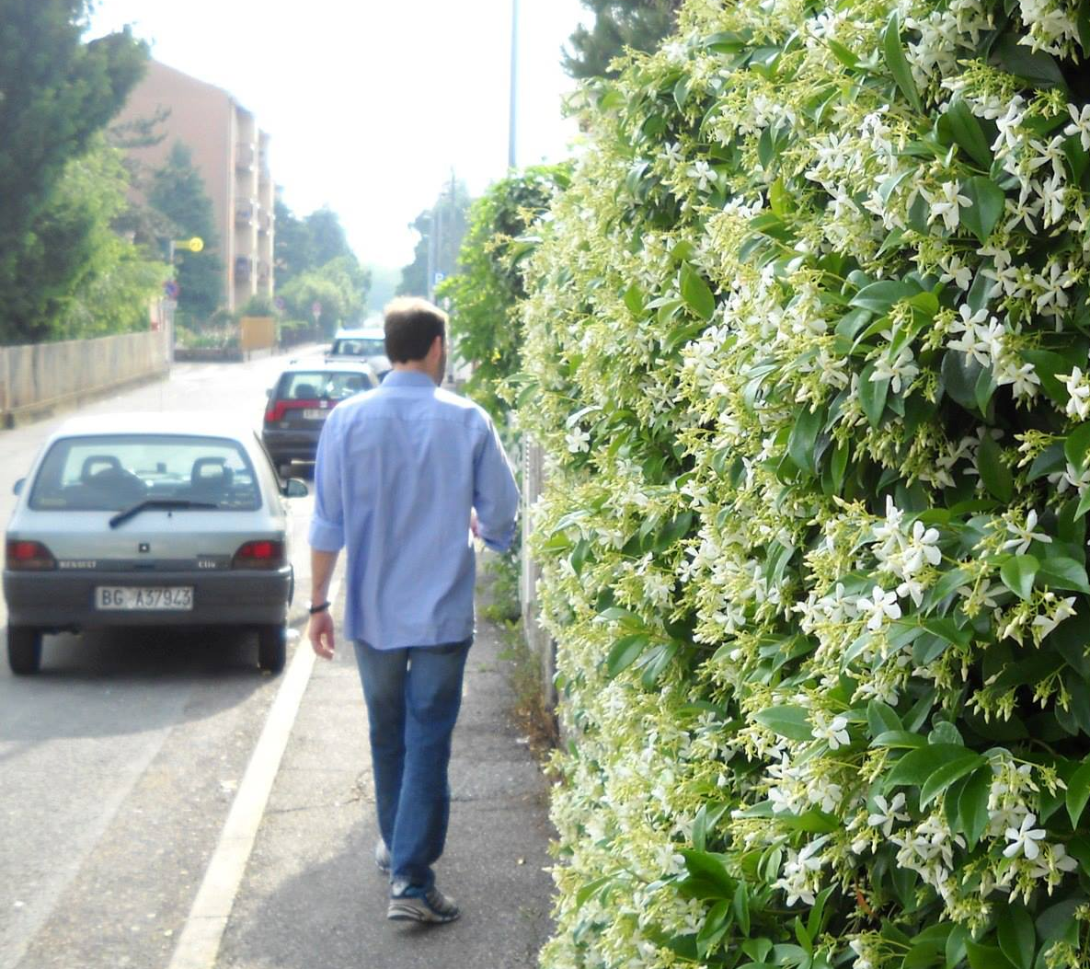
What was happening in 2013?
Jason Isbell releases “Southeastern”
China lands rover on the Moon
First human embryonic stem cells cloned
Notre Dame loses to Alabama
  Pope Benedict XVI resigns
Tolkamp et al. win Ig Nobel Prize in Probability for the paper, “Are cows more likely to lie down the longer they stand?”

Slide 3
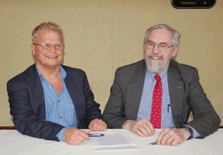
Change was in the air at USDA
“There is no doubt the amount of genomic evaluations calculated on a monthly basis has exploded. As this has taken place, those at USDA and AIPL wanted to refocus efforts on research and sunset the service function. As a result, traditional genetic evaluations were also folded into the discussion of a public-private transfer.” – Corey Geiger
Everyone in upper management at USDA who championed this decision was eventually promoted

Slide 4
AIPL Staff and Scientists (2004–2016)
27

Slide 5
Value of Incoming Data
Data Received in 2014 | Annual Value
Phenotypes from DHI
4 million cows x $1.25 / cow / mo | $60 million
Genotypes from CDCB
15,000 medium density x $125 | $2 million
258,000 low density x $45 | $12 million
Whole genome sequence data (2015)
200+ bulls x $1,000 (AGIL data) | $0.2 million
1,000+ bulls x $3,000 (World data) | $3 million
Total | $77.2 million

Slide 6
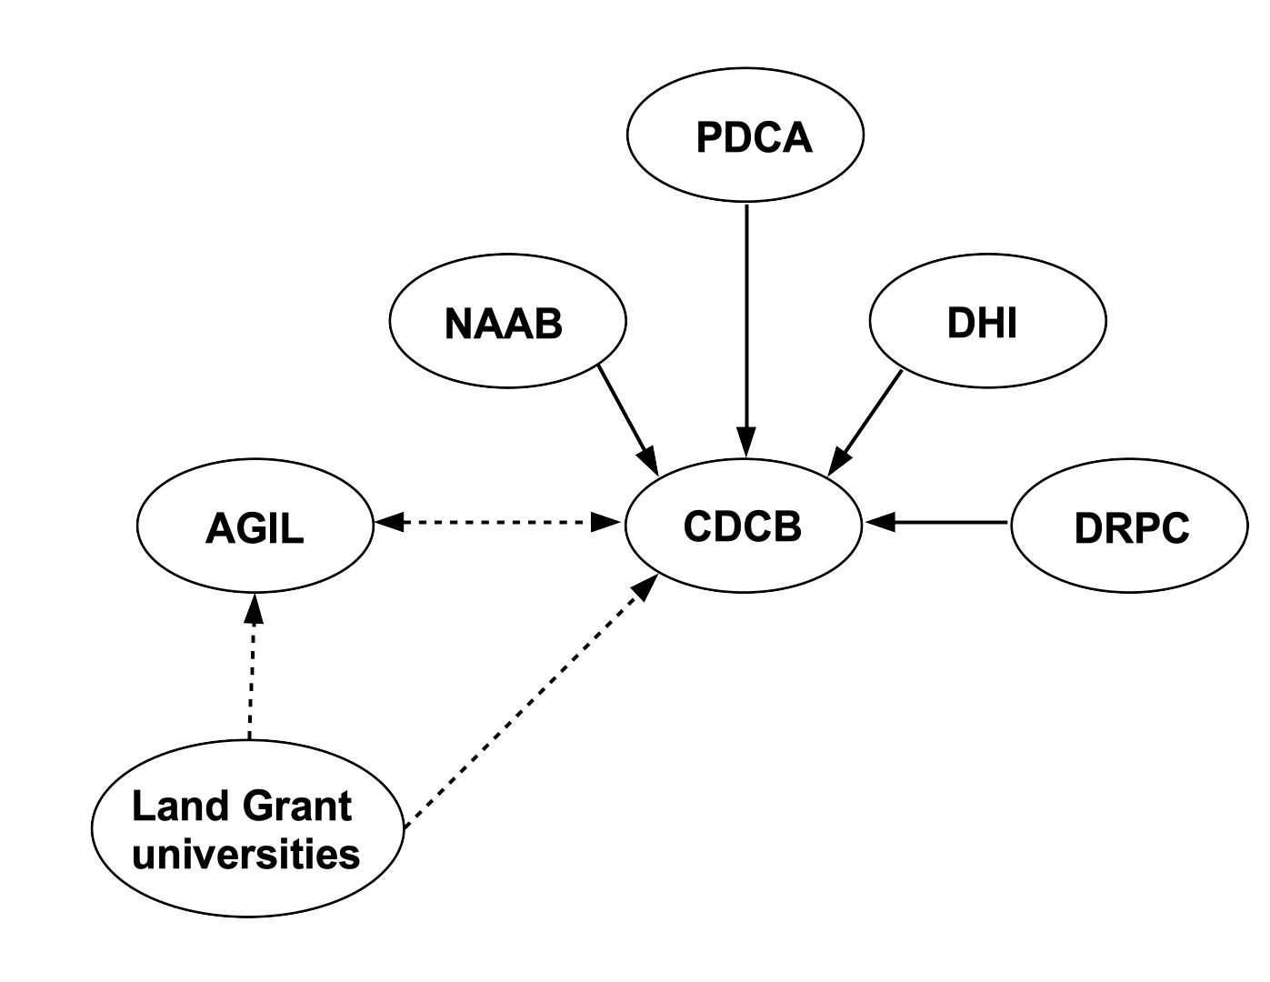
Why was the transition successful?
Trust: Built on decades of collaboration around the milk recording and genetic evaluation systems
Continuity: Operational staff were willing to join CDCB, and key scientific personnel at AIPL remained in place
Leadership: The CDCB board selected an outstanding individual to lead the new organization into the future
Necessity: Trustworthy genetic evaluations are needed and everyone wanted a good outcome

Slide 7
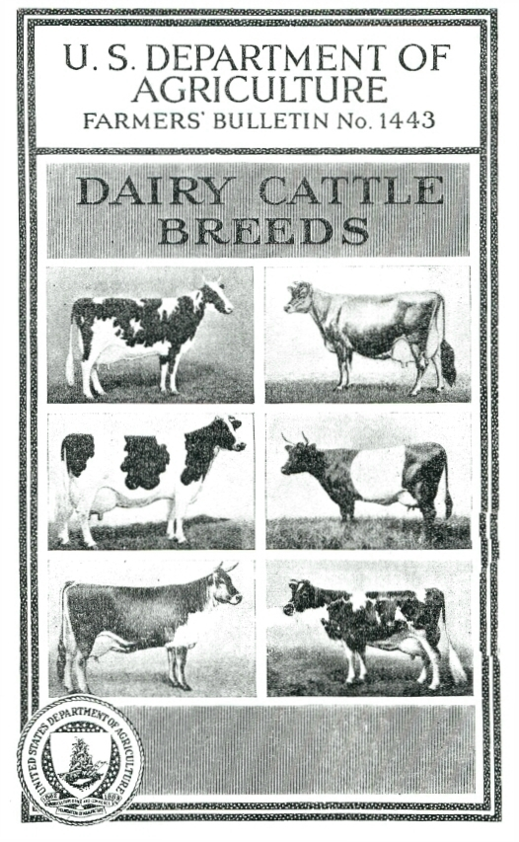
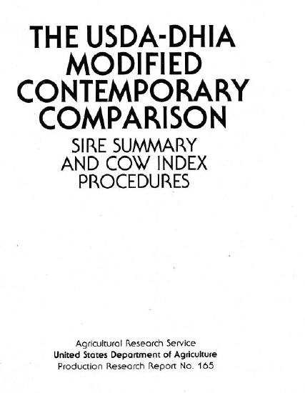
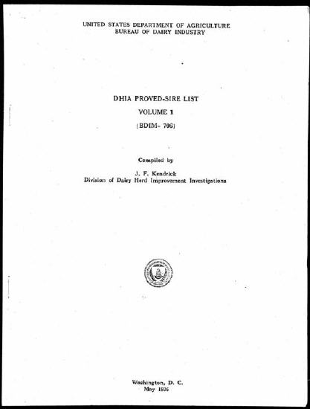
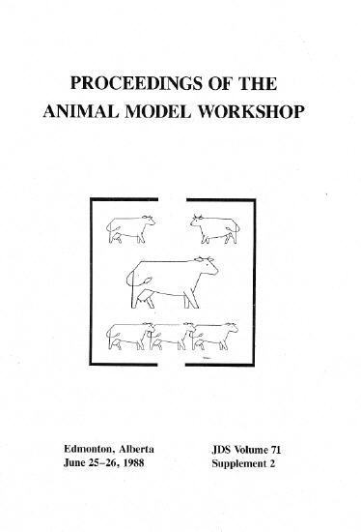
How is CDCB growing that legacy?
Continuing the AIPL tradition of delivering value to dairy farmers
Telling their story instead of waiting for others to do it
Innovation with internal and external partners
Building their own culture
Bringing the best people from around the world onto the team
Educating future leaders

Slide 8
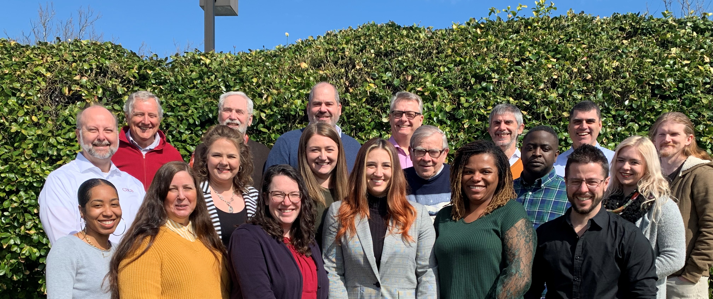
Ten years later…

Slide 9


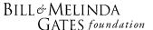

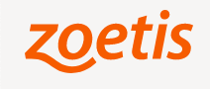


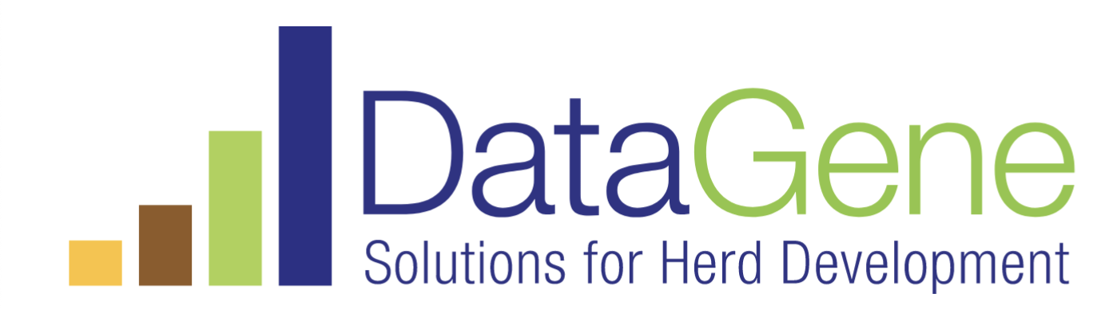
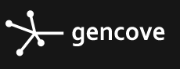




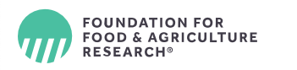





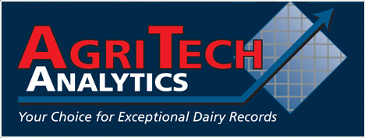






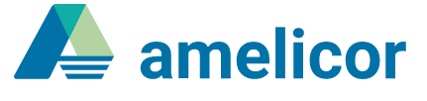


What’s changed outside of CDCB?

Slide 10
